Slide 1

Book Store System
By:
Hasnain Haider (Group Leader)
Matthew Bozelka
Pegah Sattari
Siddhanth Sabharwal
Timothy Walker
Computer Science 2B: Intermediate Software Design in C++
Instructor: Tri Pham
Assignment: Class Project

Slide 2
Problem Statement
Objectives:
  To develop a software program that can manage a bookstores inventory, employee databases and transactions.
  To develop an inventory management system that is intuitive and easy to use for someone with no programming knowledge
  To develop a searching procedure that is fast and efficient for the employees

Slide 3
Design Goals
Must be able to search inventory for Books, eBooks and Audio Books.
  Search by ISBN and Product ID
  Display current inventory
Must be able to display and manipulate the inventory database
  Add, remove and display inventory items.
Must be able to display and manipulate the Employee database.
  Add, remove and display current employee.
Must be able to display and manipulate transaction database.
  Place new orders, remove existing orders and display current orders

Slide 4
CLASS:
Item Hierarchy:
  All the items that can be ordered
  Item, InventoryItem, Product, Book, PaperBook/eBook/AudioBook
Person Hierarchy:
  Children are Employee and Customer. Employee is parent to Manager.
Order Hierarchy:
  Currently only one child: StoreOrder. Time did not permit CustomerOrder.
List Hierarchy:
  InventoryList of all items, EmployeeList of all employees, OrderList of all orders.
BookStoreSystem: Reads data from the three database files and shows menu to add/remove/view item/employee/order

Slide 5
MAIN PROGRAM:
The program begins by reading in a list of databases required.
The user then logs in with their Employee ID
The employee is then presented with a menu list of options to choose from
The first three options prints out the store’s databases and important details
Options 4-6 allows the user to interact with the databases to edit employees (Add a new employee, edit an existing, or remove an employee), edit store transactions (Reorder, Order new, remove an order, or view an order), and edit the inventory (Add new, remove, and view)
Finally, the user can search a book by ISBN to help out customers

Slide 6
HOW CLASSES INTERACT
List
BookStoreSystem
EmployeeList
InventoryList
OrderList
Item
Person
InventoryItem
Employee
Customer
Product
Order
Manager
Book
StoreOrder
eBook
PaperBook
AudioBook

Slide 7
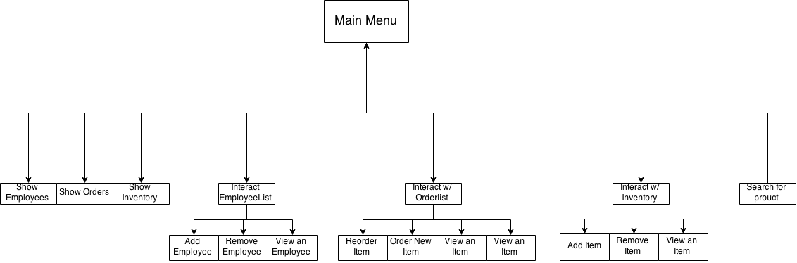
Menu Control

Slide 8
DEMO

Slide 9
FUTURE RELASES
We hope to incorporate a keyword search feature that allows employees to search for items by partial titles and authors.
Generate sales reports for the owner by most popular book, author, etc.
Additional functionality specific to managers such as custom discounting items, automatically creating seasonal sales
Some functionality that recommends books to customers by their past purchases, and demographic match

Slide 10
CONCLUSION

